Slide 1

Parkinson's Disease Detection

Slide 2

Contents
Introduction
Objectives
Work Flow
Explanation Of Models Used
Results

Slide 3
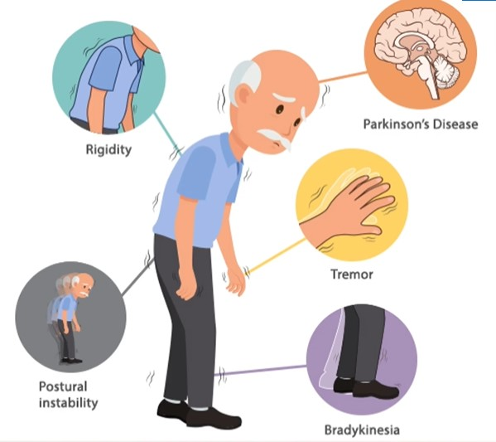
Introduction:
Parkinson's disease is a neurodegenerative disorder that affects millions of people worldwide.
Early and accurate diagnosis is crucial for providing timely treatment and improving patients' quality of life.
In this presentation, we will explore the use of machine learning, specifically Support Vector Machines (SVM), for classifying Parkinson's disease based on patient data.

Slide 4
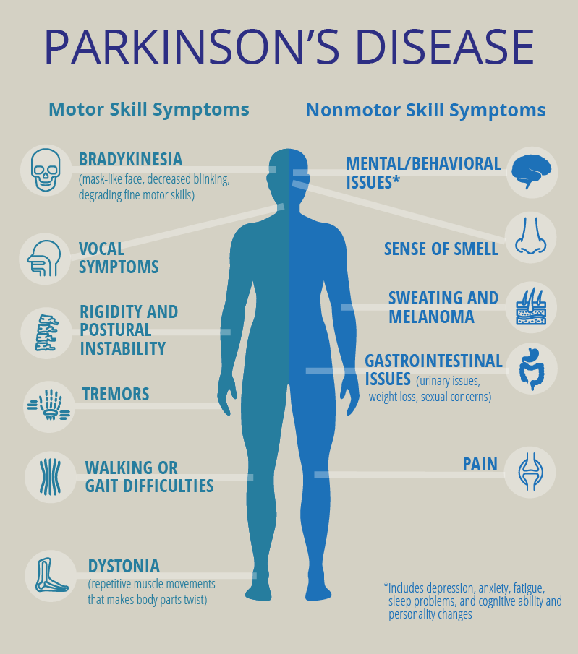
OBJECTIVE
Understand the importance of accurately classifying Parkinson's disease.
Introduce Support Vector Machines (SVMs) as a tool for binary classification.
Thoroughly analyze the structure and characteristics of the Parkinson's disease dataset.
Demonstrate key data preprocessing steps, including feature selection and scaling.
Discuss the selection of SVM as the classification model and the use of a linear kernel.
Evaluate the SVM model's performance using various metrics on both training and test data.
Show how to use the trained model for predictions on new data.
.

Slide 5
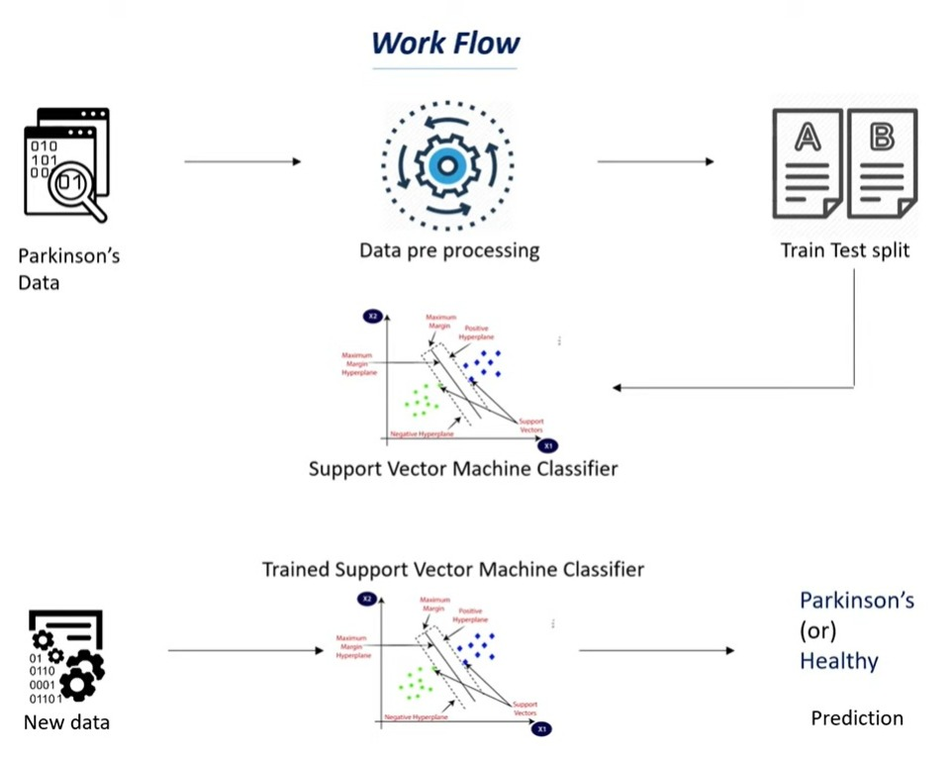
WORKFLOW

Slide 6
USED MODELS
NumPy (np)
Pandas (pd)
train_test_split
Used for numerical computations and working with arrays.
Used for data manipulation and analysis with Data Frames.
from sklearn.model_selection
Splits the dataset into training and testing subsets.
StandardScaler
SVM
accuracy_score
from sklearn.preprocessing
Standardizes features for consistent scaling.
from sklearn
A powerful classification model for separating different classes.
from sklearn.metrics
Measures classification model accuracy

Slide 7
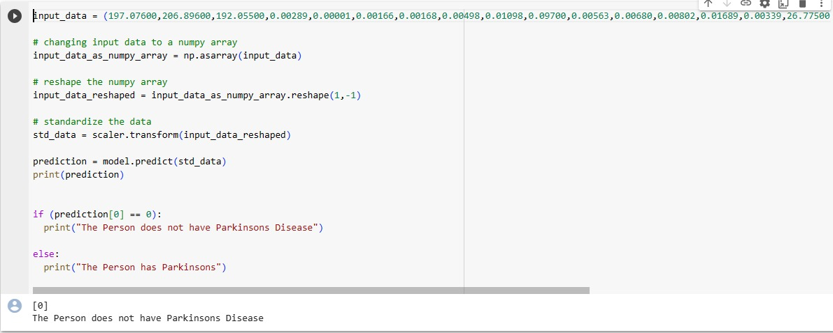
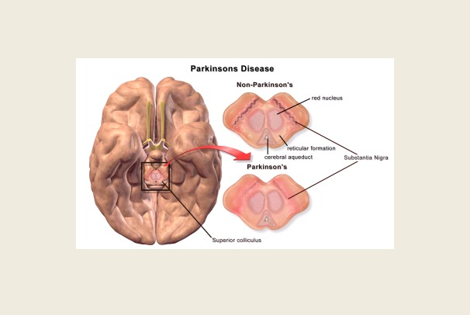
RESULTS

Slide 8

Thank You

